Slide 1
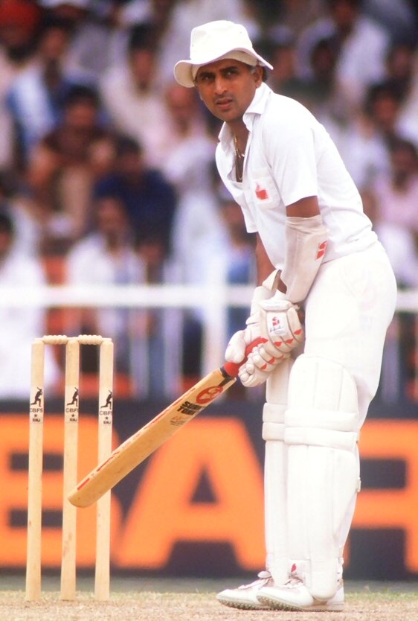
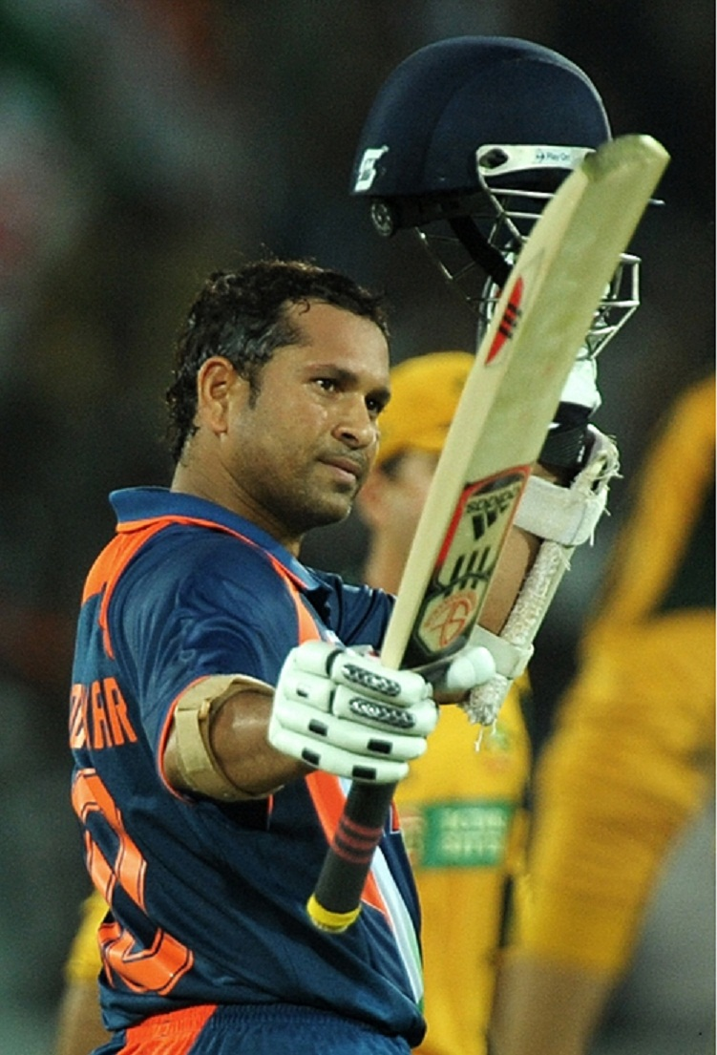

Slide 2


Slide 3

Combined experimental and numerical studies of soft matter and biological systems
Bachir Aoun, Eric Pellegrini, Mark Johnson
Computing for Science (CS)
January 2013

Slide 4
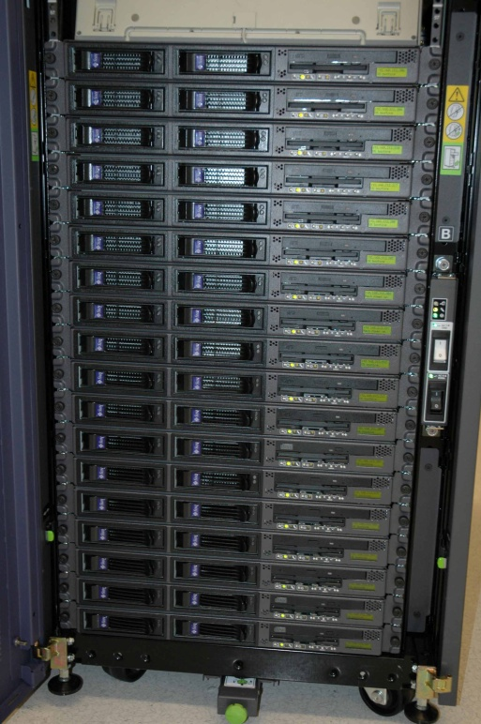



Numerical experiments...
‘instrument scientist & technician’
Instrument = cluster
Inst control software = MD
Data analysis software = nMoldyn
Notes:
X-ray and C-Lab examples make point of using a common platform
Another weak point is duplication, next slide

Slide 5
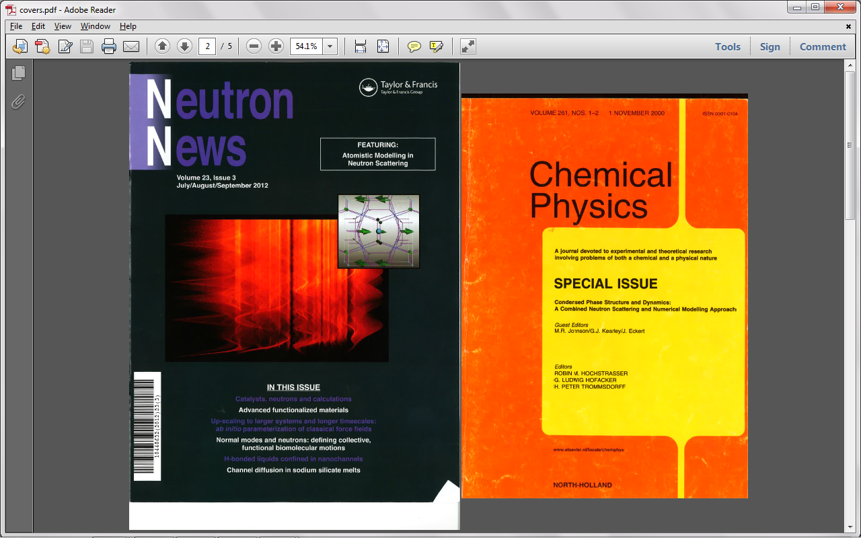
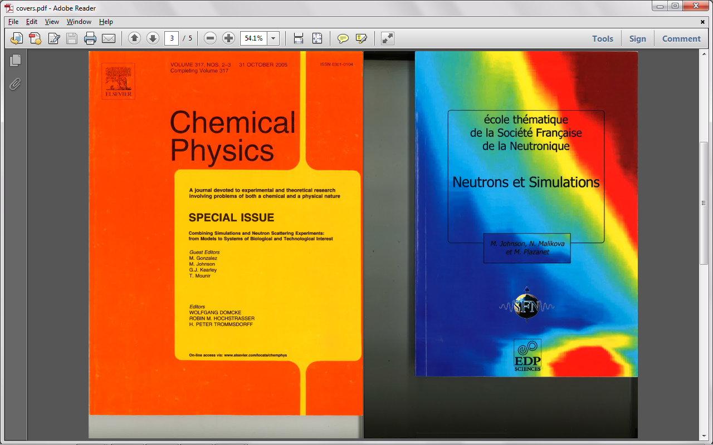
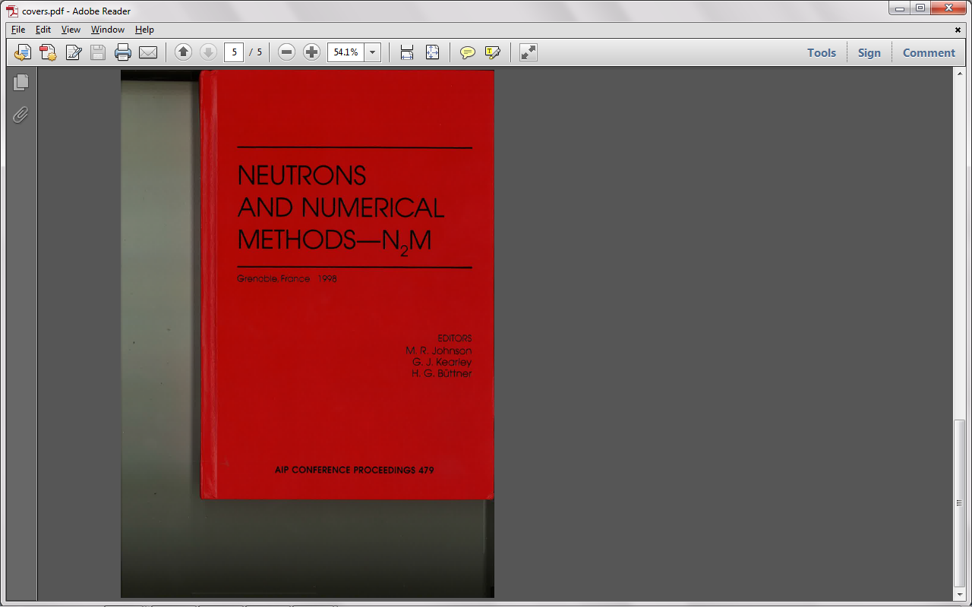
... Since 1995
Notes:
X-ray and C-Lab examples make point of using a common platform
Another weak point is duplication, next slide

Slide 6
C-Lab proposals since 2007
Notes:
Range of work

Slide 7
Proposal distribution across colleges/fields
Notes:
Range of work

Slide 8
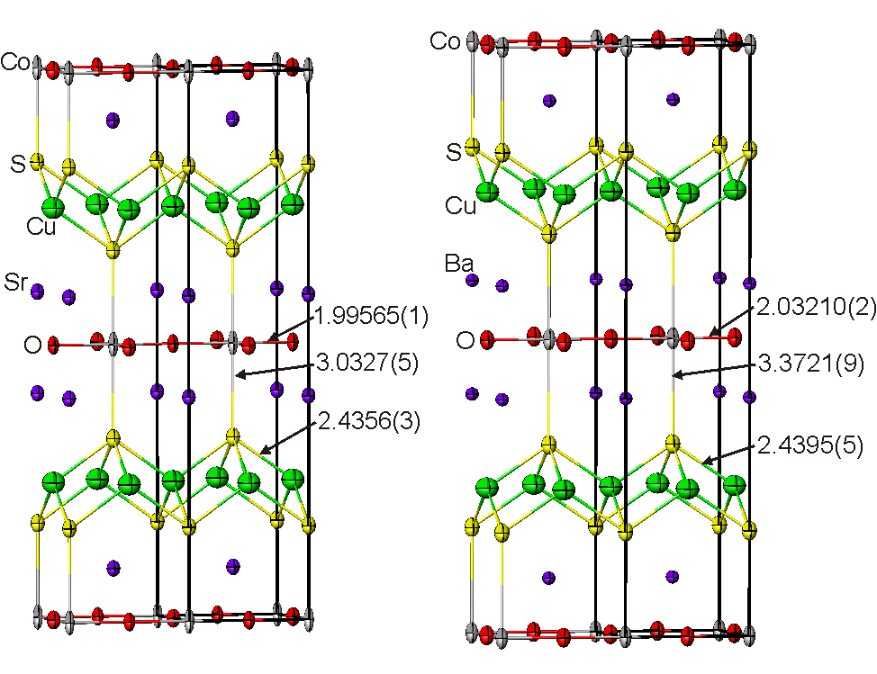
C5 - diffraction
Notes:
See beautiful results
How have we contributed?
C-lab
A few production tools
Non production stuff is theory -> group
Advanced data analysis
2 tools: DFT and classical MD
Like diffractometer and spectrometer -> range of science

Slide 9
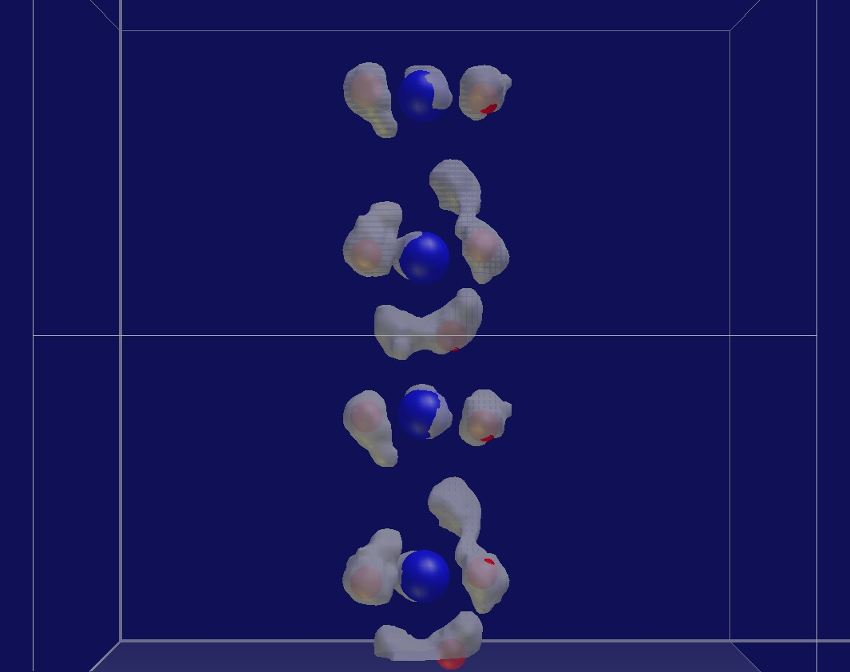
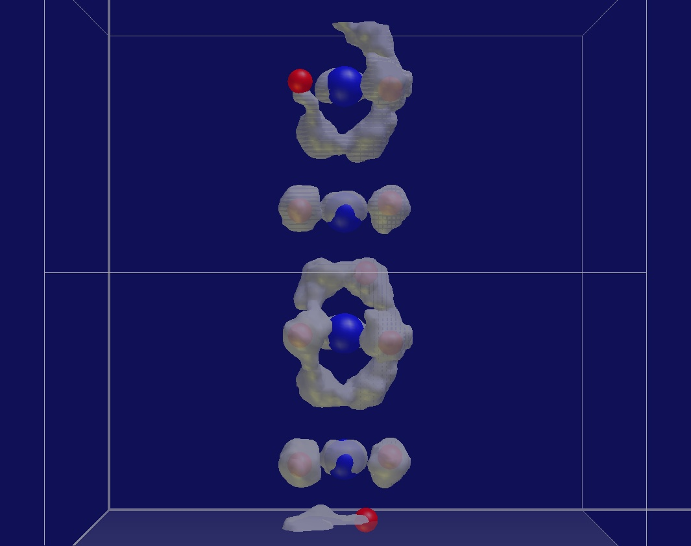
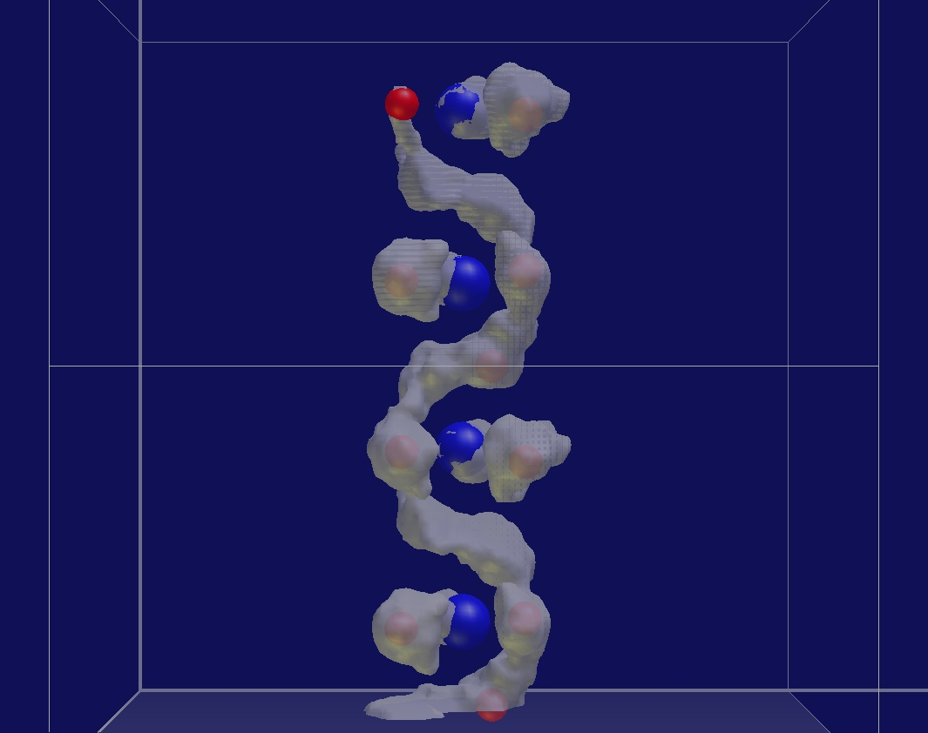
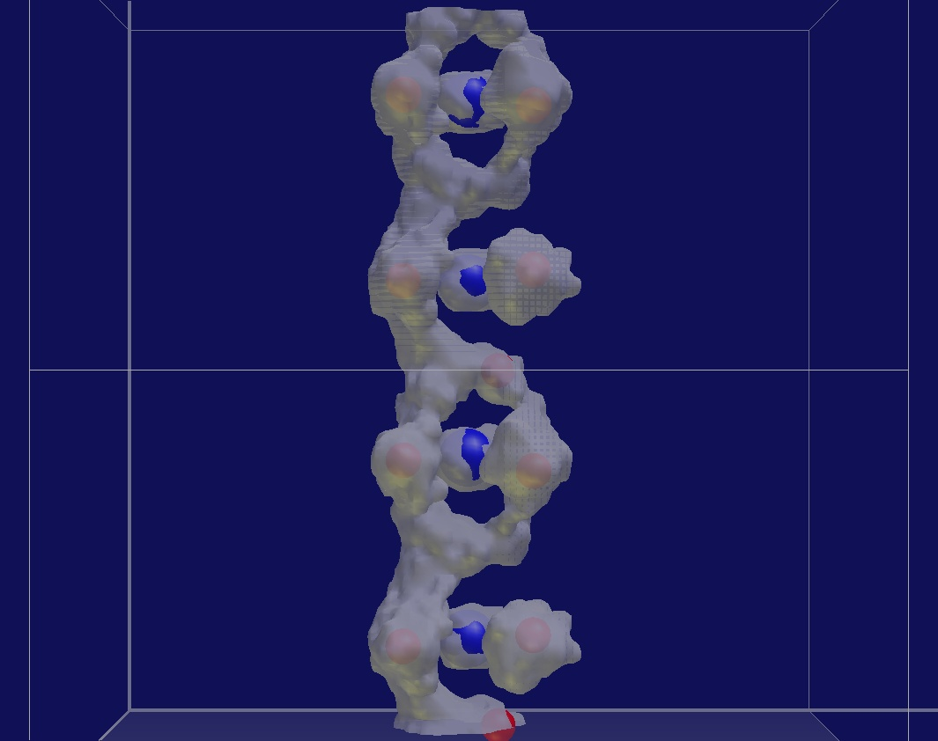
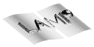
C5 - diffraction
Temperature

Slide 10
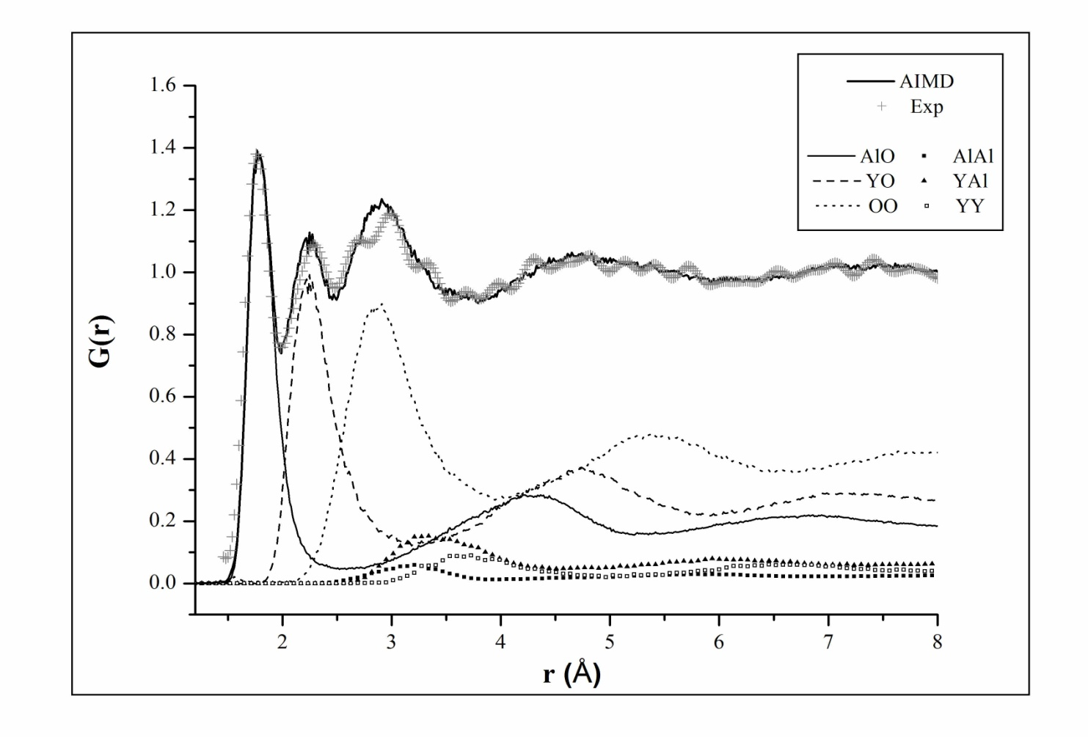
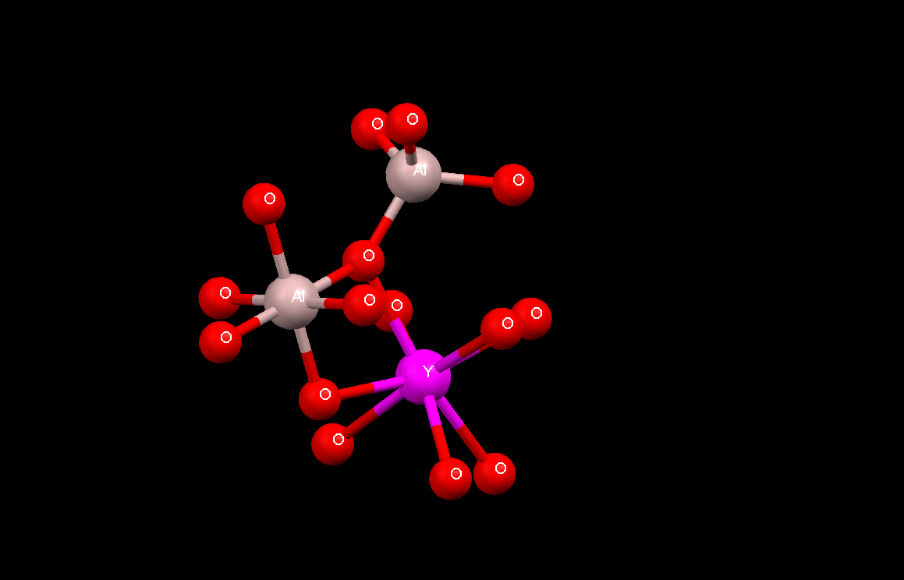
C6 – (ionic) liquids
YAG
Notes:
Range of work

Slide 11
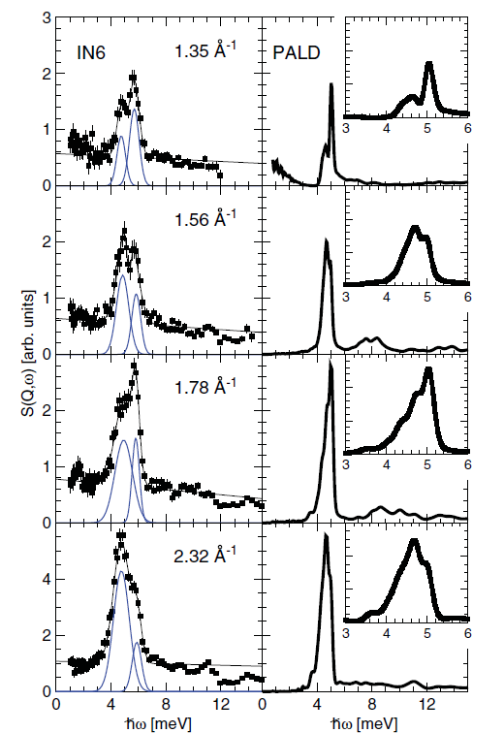

C7 - spectroscopy

Slide 12
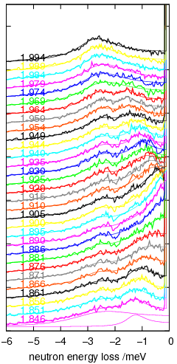
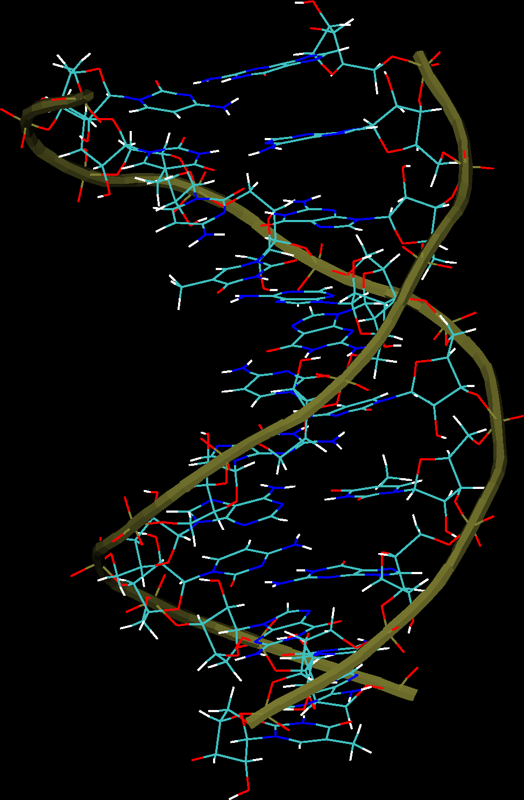
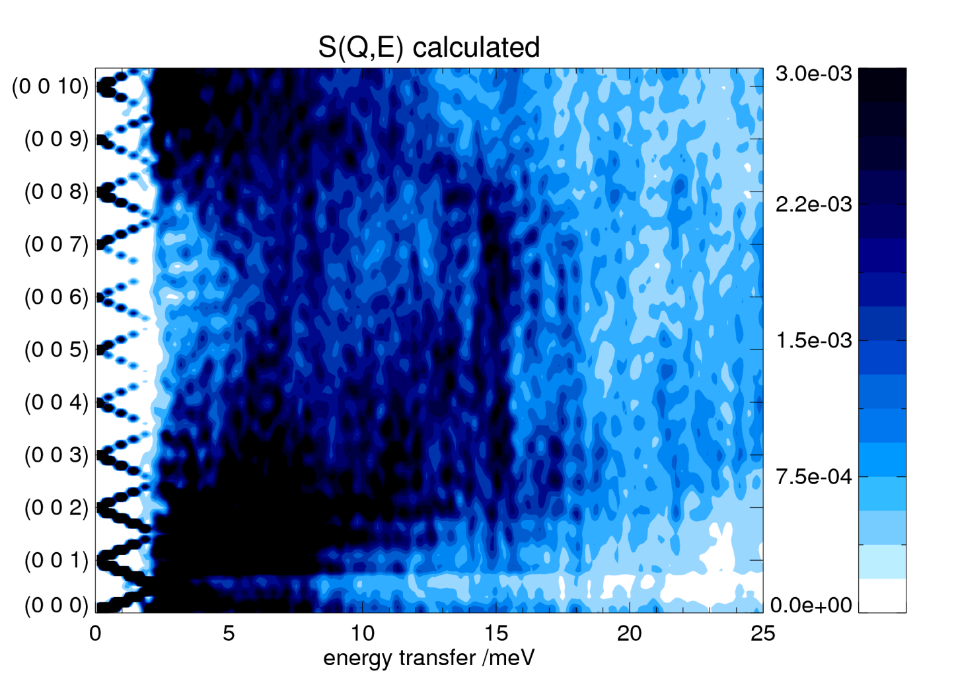
C7 - spectroscopy

Slide 13
Colleges 8 & 9 – soft matter & bio
Growth area at ILL: 2 → 3 colleges
Supported at ILL by
D-Lab & PSB – Partnership for structural biology
PSCM – Partnership for Soft Condensed Matter
Can we do (large scale atomistic) simulations effectively and efficiently in this area?
Notes:
Range of work

Slide 14
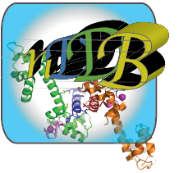
nDDB – neutron Dynamics Data Bank (Grenoble + L. Rusevich + Vicky GS)
Given the importance of protein dynamics for biological function
And the inherent complexity of individual systems
Build a coherent set of neutron scattering results
~300 papers reviewed
No systematic comparison of experiment with simulation – why would this be interesting?
Notes:
Range of work

Slide 15
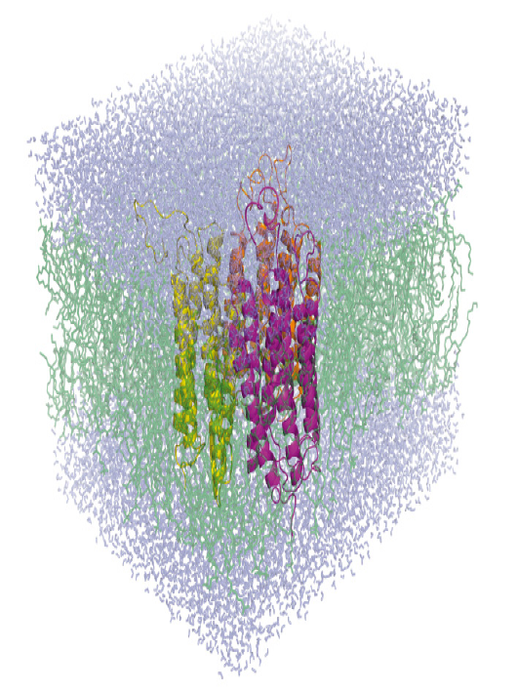
Bacteriorhodopsin – photon triggered proton pump
(with Katy Wood, Joe Zaccai et al.)
sample simulation: MD ~ 90 000 atoms

Slide 16
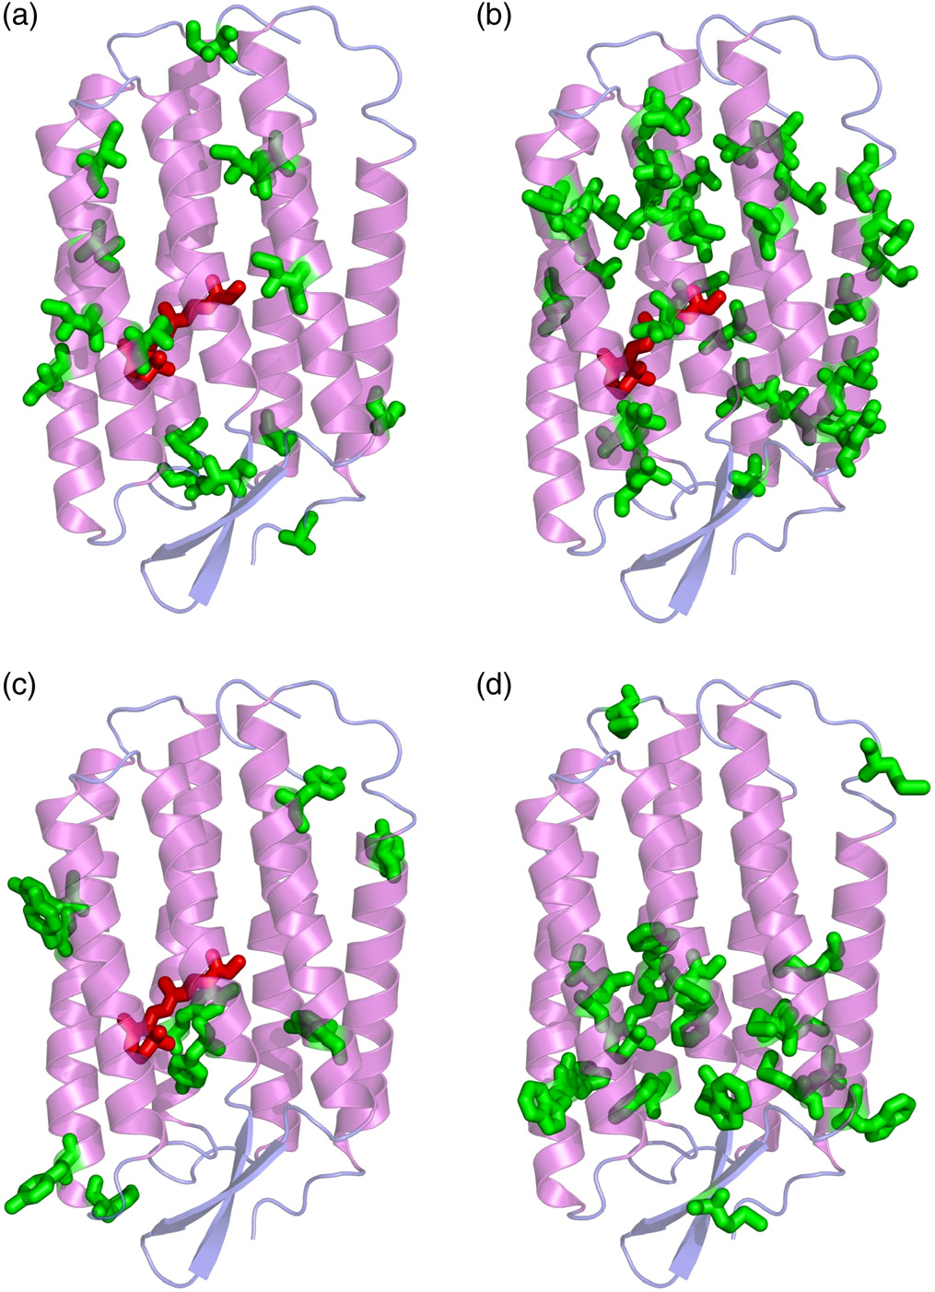
BR dynamical heterogeneity
(a) – isoleucines
(b) – leucines
(c) – tyrosines
(d) - methionines, tryptophans and retinal.

Slide 17
BR dynamical heterogeneity
Isoleucines:
Biggest MSD
Leucines:
Average MSD
LEGEND
Solid line:
Average expt MSD
Open points:
Labelled BR MSDs
Crosses:
Average calculated MSD
Solid points:
Residue specific MSDs
Tyrosines:
Smaller MSD
Methionines etc:
Smallest MSD

Slide 18
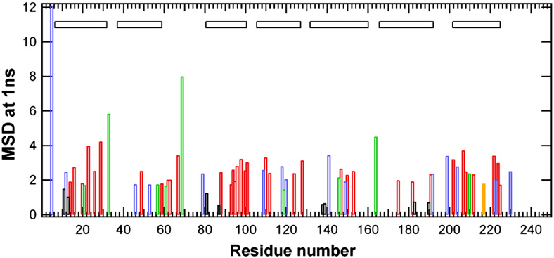
BR dynamical heterogeneity: the map
Ile4
Isoleucine (blue), leucine (red), methionine (green), tryptophan (black)

Slide 19
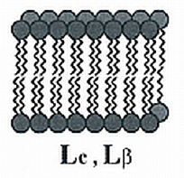
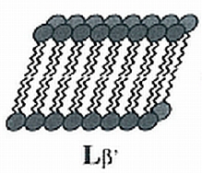
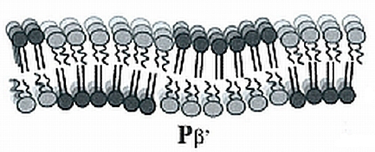
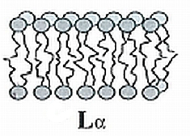
Lipid membranes only – DMPC (with F. Natali, J. Peters et al.)
L_{c} = lamellar crystalline phase
most ordered
no lateral lipid diffusion
low temperature
L_{β’} = quasi-crystalline phase
‘gel’ phase
alkyl chains tilted (DMPC=30°)
P_{β’} = meta-stable transition
‘ripple’ phase
gel and liquid rafts
L_{α} = liquid phase
no long-range order
physiological state
287K
297K

Slide 20
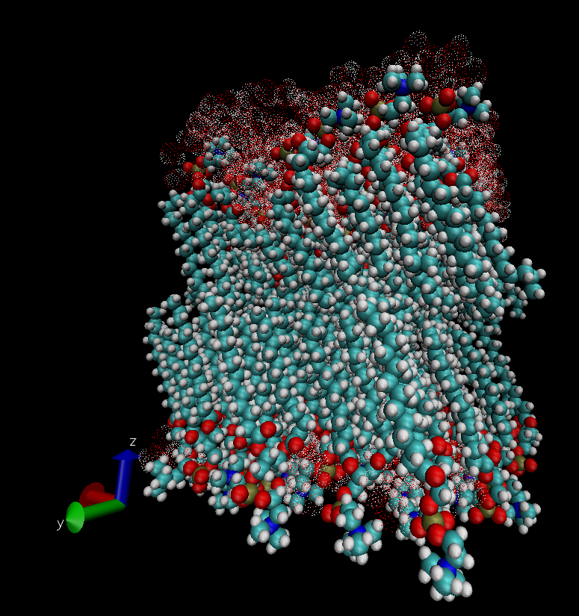
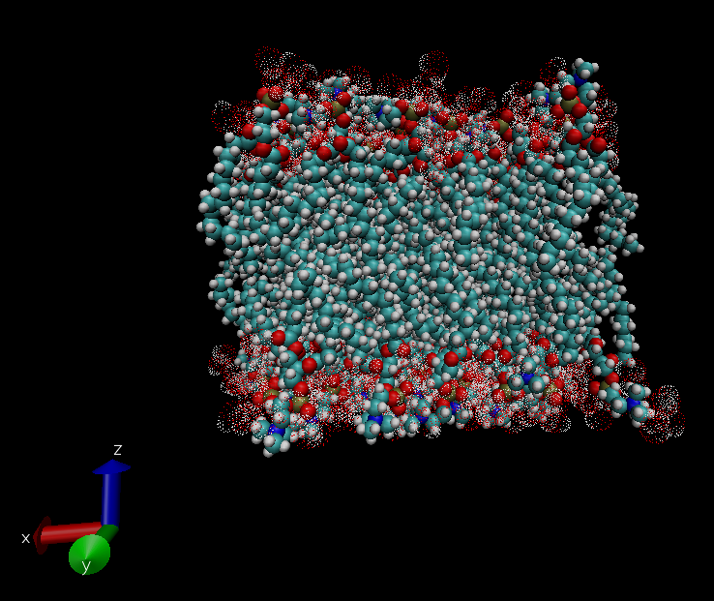
DMPC – gel and liquid phases
Notes:
Intro membranes and transitions

Slide 21
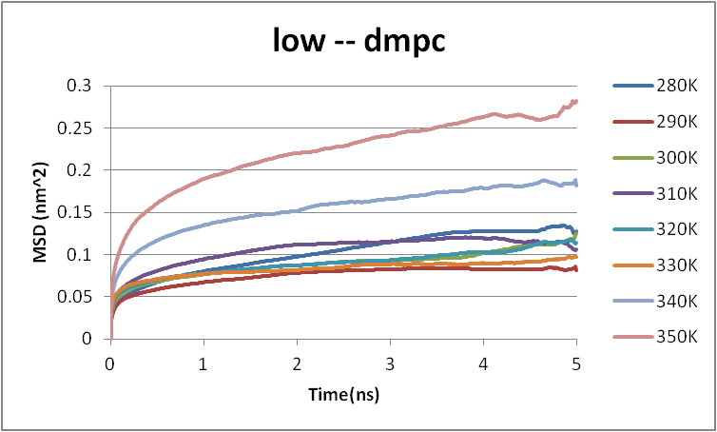
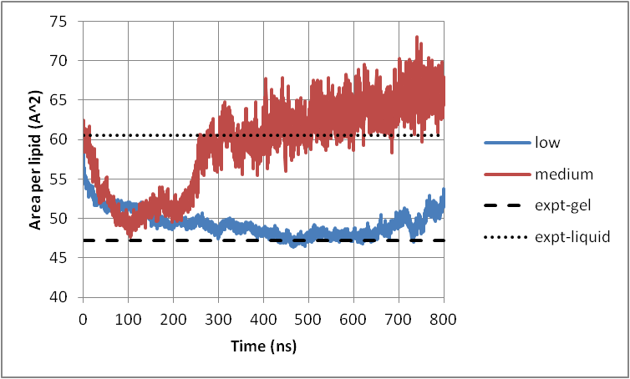
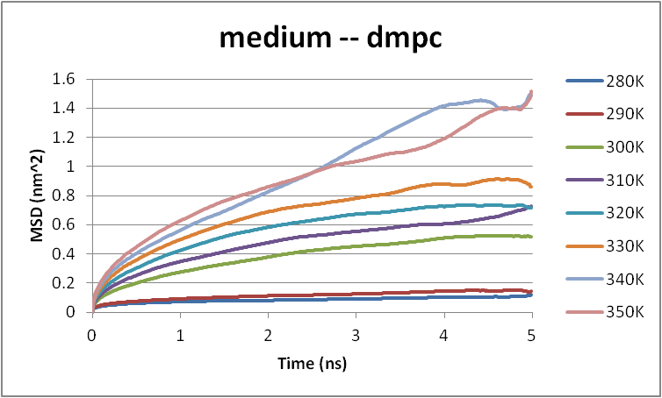
Lamellar DMPC – structure Tc=300K
280
290
300
310
320
330
340
350
K
Notes:
Intro membranes and transitions

Slide 22
Agreement with spherical DMPC - liposome

Slide 23
Disagreement with lamellar H-DMPC (OK for some D-DMPC)
Notes:
Data showing mobility depending on hydration: dry, 4, 6, 12 H2O
Main gel-liquid phase transition at 297K, pre-trans 10K earlier

Slide 24
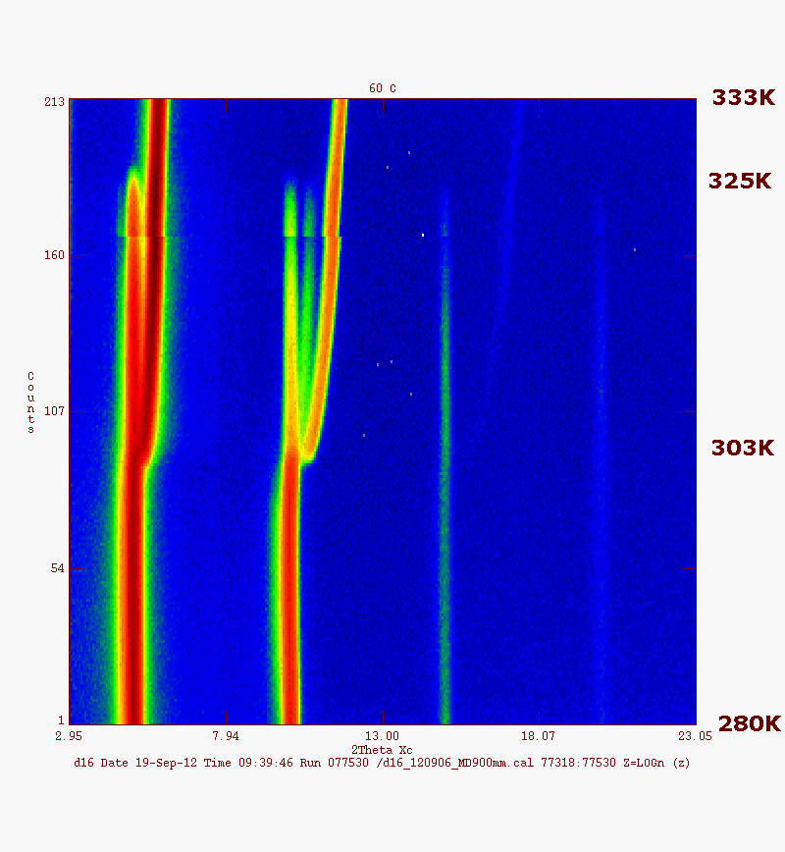
DMPC – structure answer
LIQUID
EXPECTED AT ~300K !
GEL & LIQUID RAFTS
GEL

Slide 25

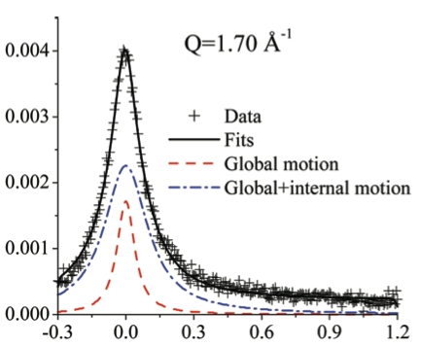
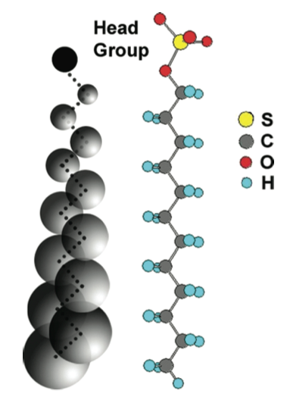
Structure & dynamics of micelles (with Mukho, Vicky GS et al.)
IRIS basckscattering, 0.17micro-eV

Slide 26
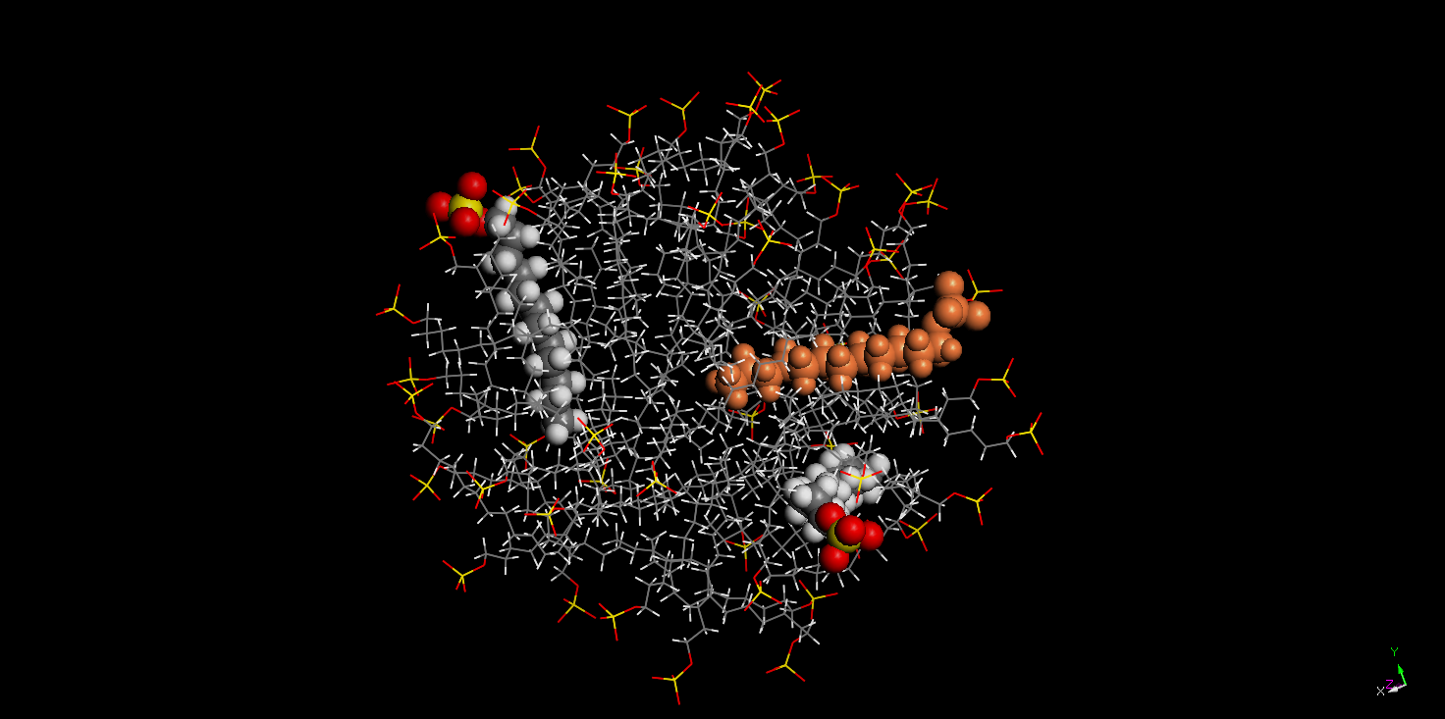
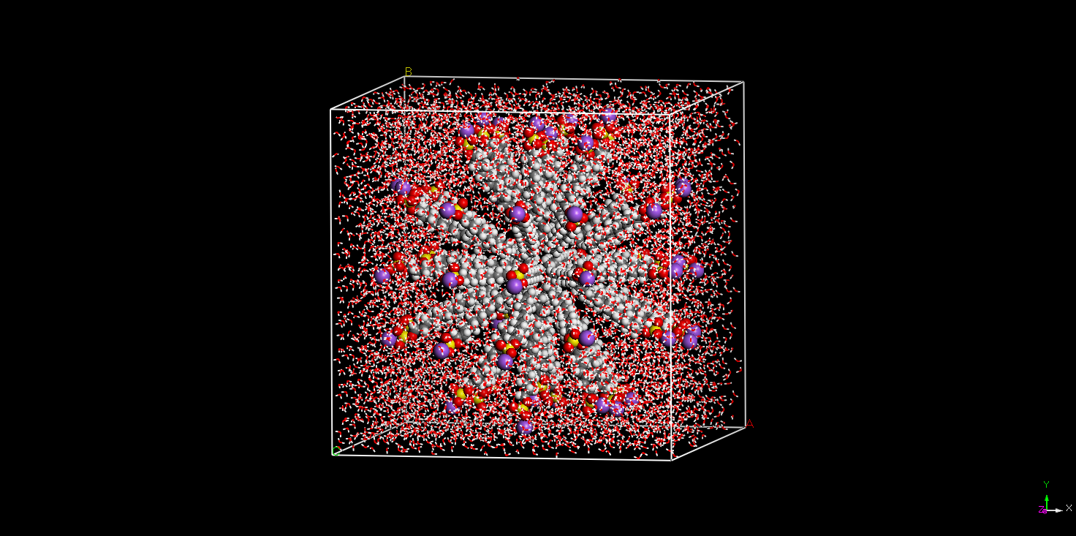
SDS – structural model
Notes:
Discuss how physically reasonable this model is

Slide 27
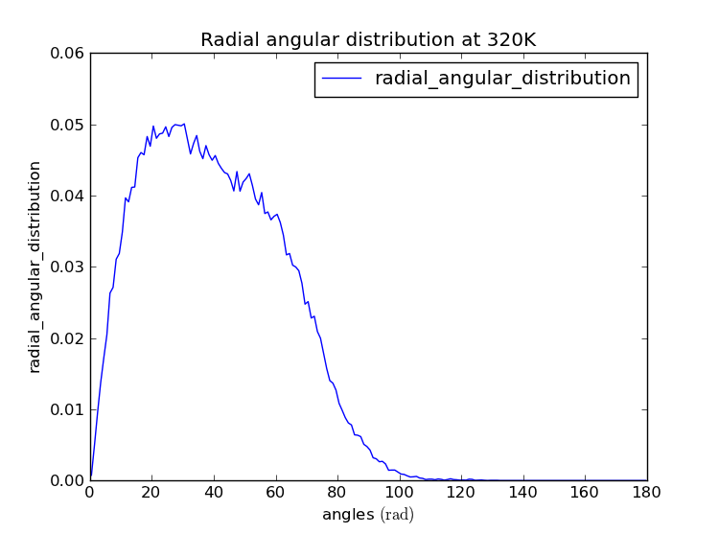
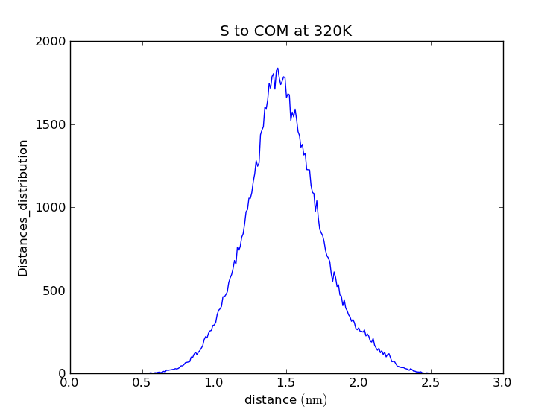
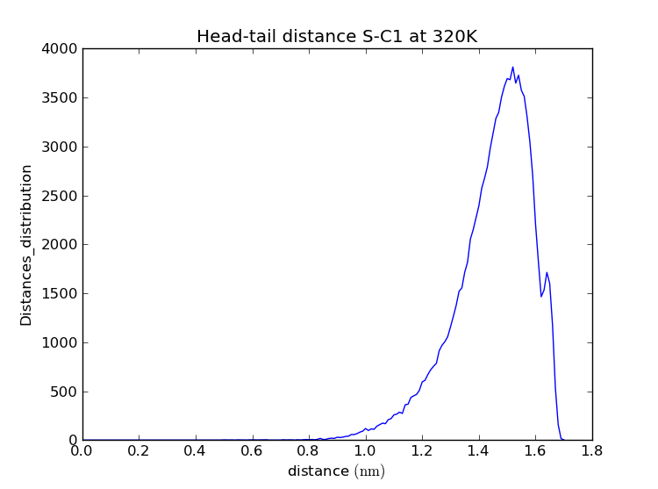
SDS – structural model: ‘rough ellipsoid’
Notes:
Head-tail distance shows mainly extended (trans) conformation
S to COM distance shows 5AA HWHM
Angular distribution shows wide range of orientations including some tangential molecules
For Bachir – just show 320K data, for angles show normalised and not normalised data, need image of molecule

Slide 28
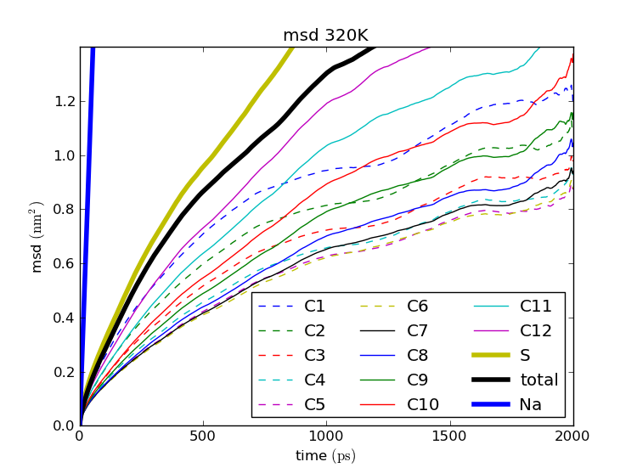
SDS – dynamical model
Notes:
Linewidths in good agreement with expt (IRIS, IN5)
MSDs suggest a double cone motion
Head group partially in water

Slide 29
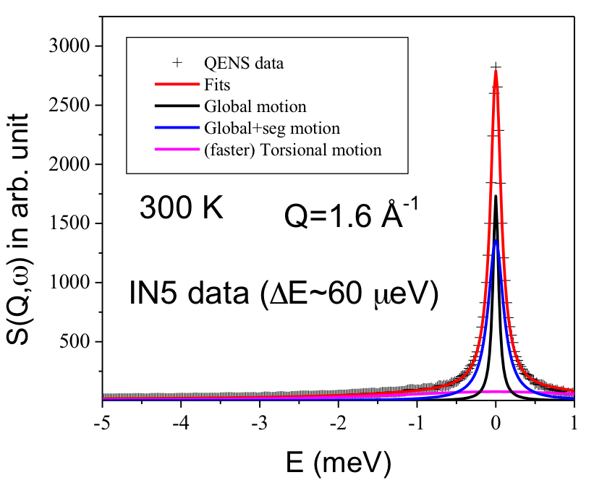
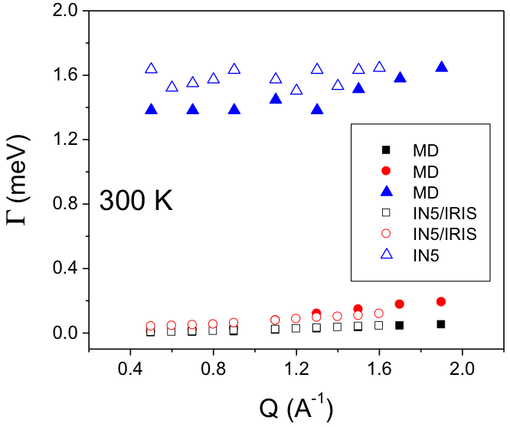
SDS – dynamical model: frequency and Q dependence

Slide 30
Conclusion...
BR – MD shows apparent high mobility of isoleucine residues is due to one residue not constrained by the membrane
DMPC – MD establishes the link between structural and dynamical transitions when the pure liquid phase is formed.
Micelles – MD suggests that the ‘heavy’ head groups have large MSD’s due to rough micelle surface and contact with water molecules.
Notes:
Linewidths in good agreement with expt (IRIS, IN5)
MSDs suggest a double cone motion
Head group partially in water

Slide 31
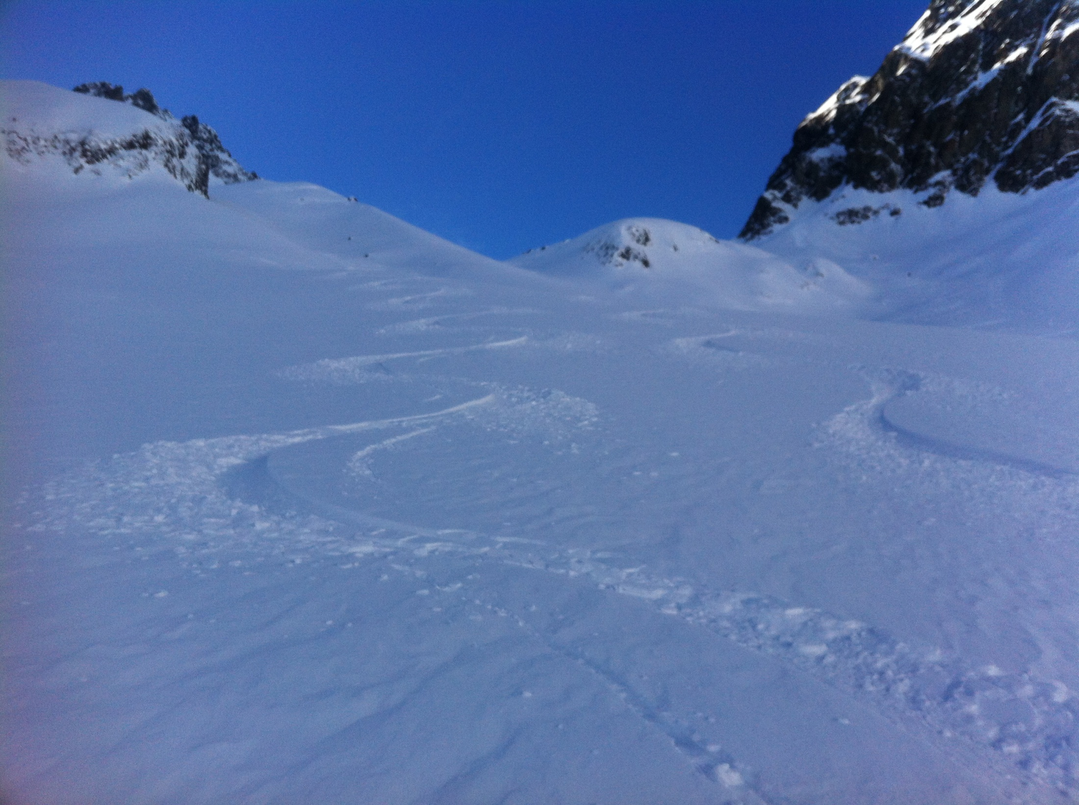
Thank you for your attention
Notes:
Linewidths in good agreement with expt (IRIS, IN5)
MSDs suggest a double cone motion
Head group partially in water

Slide 32
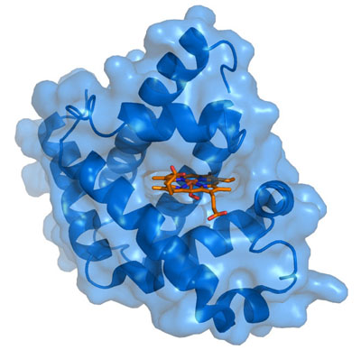
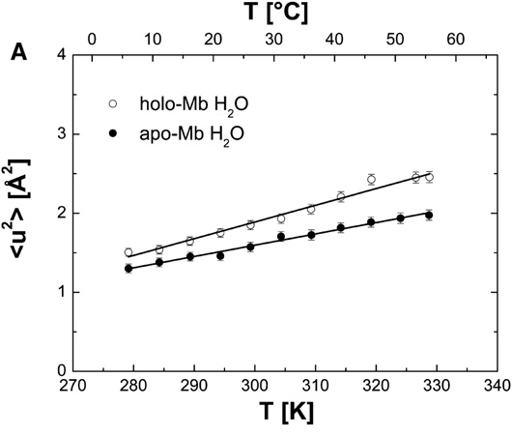
Apo/holo myoglobin
Notes:
Protein in a box

Slide 33
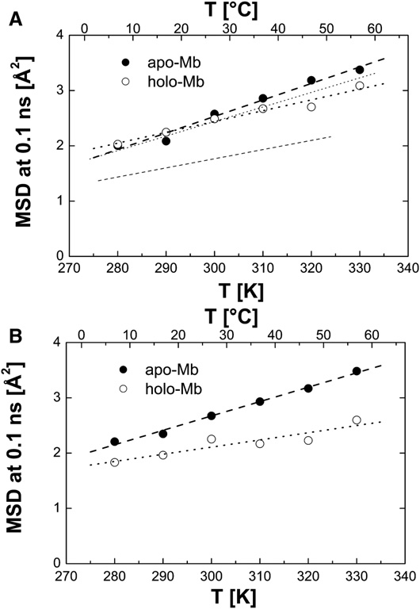
Apo/holo myoglobin (whole molecule)
Notes:
Protein in a box

Slide 34
Apo/holo myoglobin (active site)
Notes:
Protein in a box

Slide 35
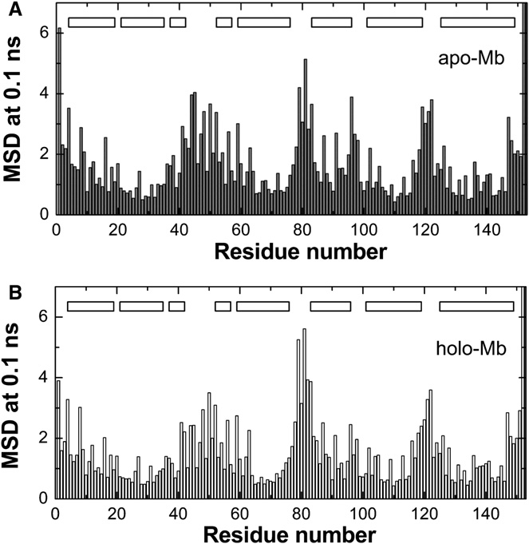
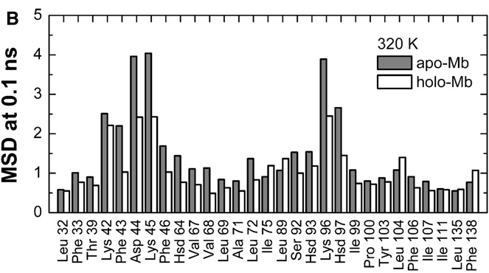
Apo/holo myoglobin
Notes:
Protein in a box

